Slide 1
Problems in Statistics & Probability
Chennai, Dec2019

Slide 2
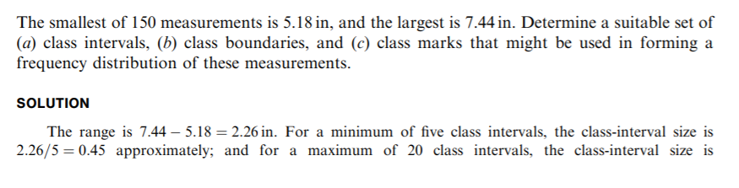
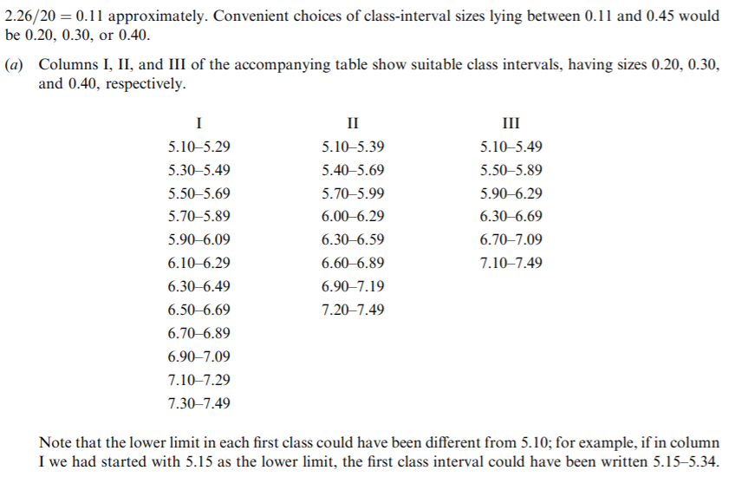
Class mark, observed values, class intervals

Slide 3
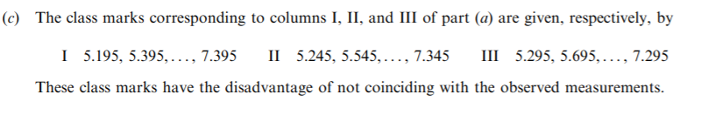
A student chose the class intervals 5.10–5.40, 5.40–5.70, . . . , 6.90–7.20, and 7.20–7.50. Was there anything wrong with this choice?
These class intervals overlap at 5.40, 5.70, ..., 7.20. Thus a measurement recorded as 5.40, for example, could be placed in either of the first two class intervals. Some statisticians justify this choice by agreeing to place half of such ambiguous cases in one class and half in the other.
The ambiguity is removed by writing the class intervals as 5.10 to under 5.40, 5.40 to under 5.70, etc. In this case, the class limits coincide with the class boundaries, and the class marks can coincide with the observed data
In general it is desirable to avoid overlapping class intervals whenever possible and to choose them so that the class boundaries are values not coinciding with actual observed data.

Slide 4
Quartiles
Use EXCEL to find Q1, Q2, Q3, D9, and P95 for the following sample of test scores:
88 45 53 86 33 86 85 30 89 53 41 96 56 38 62 71 51 86 68 29 28 47 33 37 25 36 33 94 73 46 42 34 79 72 88 99 82 62 57 42 28 55 67 62 60 96 61 57 75 93 34 75 53 32 28 73 51 69 91 35
To find the first quartile, put the data in the first 60 rows of column A of the EXCEL worksheet.
PERCENTILE(A1:A60,0.25).
EXCEL returns the value 37.75.
We find that 15 out of the 60 values are less than 37.75
or
25% of the scores are less than 37.75.
Similarly,
PERCENTILE(A1:A60,0.5) gives 57,
PERCENTILE(A1:A60,0.75) gives 76,
PERCENTILE(A1:A60,0.9) gives 89.2,
PERCENTILE(A1:A60,0.95) gives 94.1.
EXCEL gives quartiles, deciles, and percentiles all expressed as percentiles.

Slide 5
Quartiles by Hand
Test scores
25 28 28 28 29 30 32 33 33 33 34 34 35 36 37 38 41 42 42 45 46 47 51 51 53 53 53 55 56 57 57 60 61 62 62 62 67 68 69 71 72 73 73 75 75 79 82 85 86 86 86 88 88 89 91 93 94 96 96 99
First quartile (25th percentile).
Calculate i = np/100 = 60(25)/100 = 15.
Since 15 is a whole number, go to the 15th and 16th numbers in the sorted array and average the 15th and 16th numbers.
That is average 37 and 38 to get 37.5 as the first quartile (Q1 = 37.5).
To find the 93rd percentile,
Calculate np/100 = 60(93)/100 to get 55.8. (‘p’ refers to percentile)
Since this number is not a whole number, always round it up to get 56.
The 56th number in the sorted array is 93 and P(93) = 93.
The EXCEL command = PERCENTILE(A1:A60,0.93) gives 92.74.
Note that EXCEL does not give the same values for the percentiles, but the values are close.

Slide 6
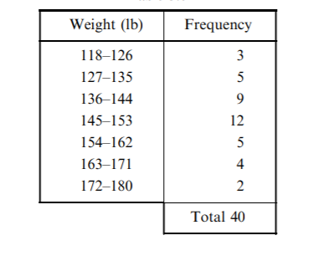
Finding the median
Data:
Now The total frequency is 40.
Mid number is 40/2 = 20.
The sum of the first three class frequencies is 3 + 5 + 9 = 17.
Thus to give the desired 20, we require three more of the 12 cases in the fourth class.
Since the fourth class interval, 145–153, actually corresponds to weights 144.5 to 153.5.
The median must lie 3/12 of the way between 144.5 and 153.5;
that is, the median is
144.5 + ( 3 / 12) ( 153:5 - 144:5 ) = 144:5 +( 3 /12 ) *9 = 146:8 lb

Slide 7
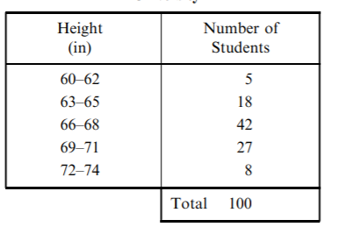
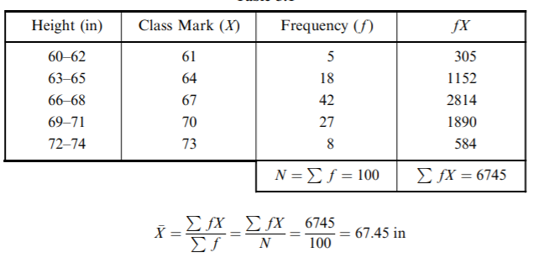
Compound mean
Compound mean
Given data
Find the standard deviation of the heights of the above 100 male students at XYZ University

Slide 8
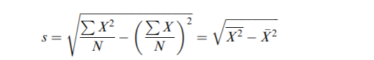
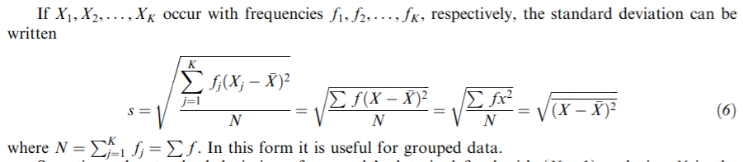
Variations
Important formulas for standard deviation

Slide 9
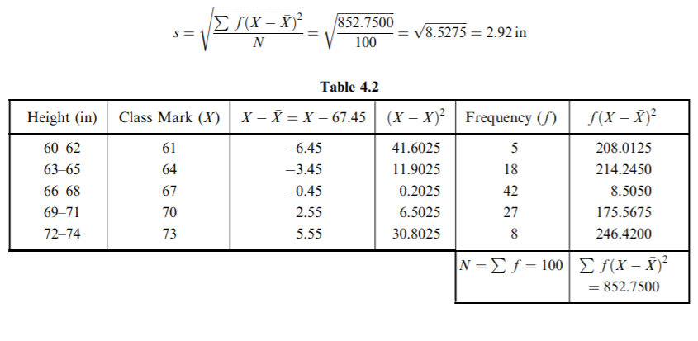
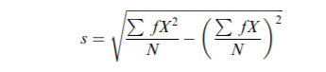
Standard deviation calculations
Find the standard deviation of the heights of the above 100 male students at XYZ University
Another useful formula

Slide 10
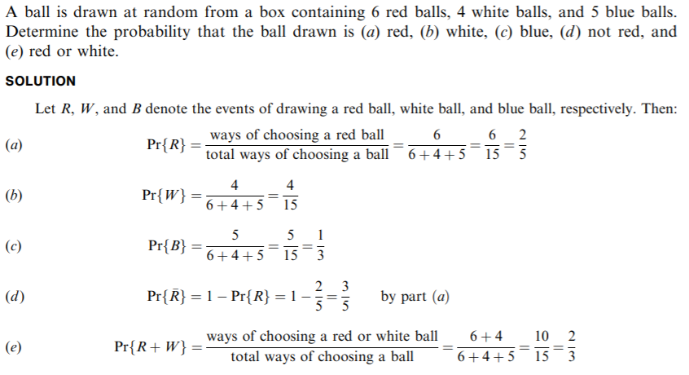
Probability

Slide 11
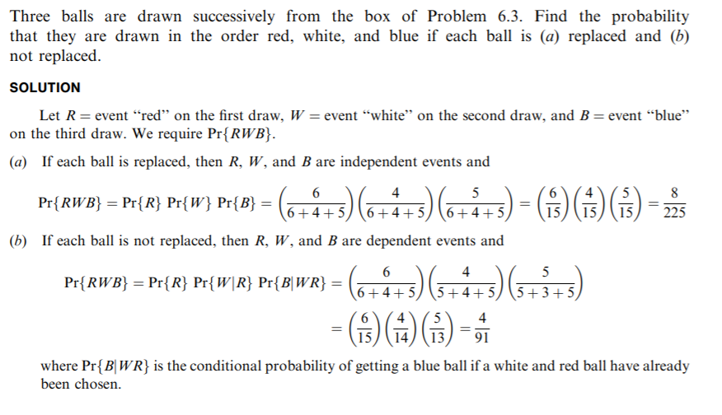
Probability

Slide 12
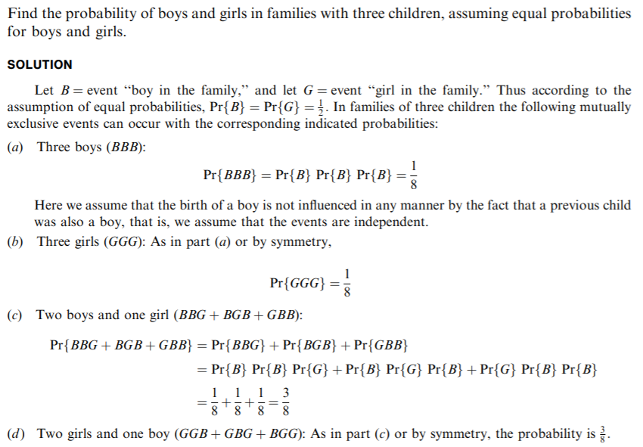

Slide 13
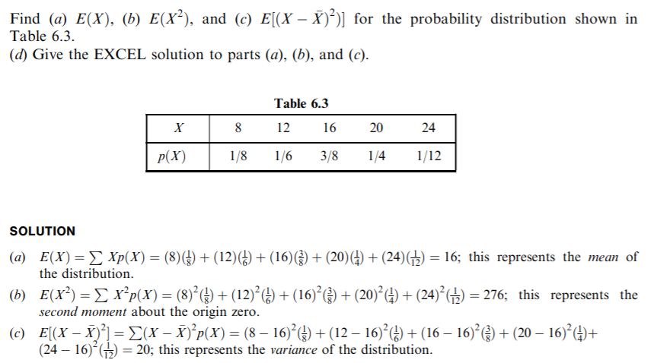
Expectation and probability

Slide 14
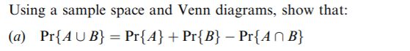
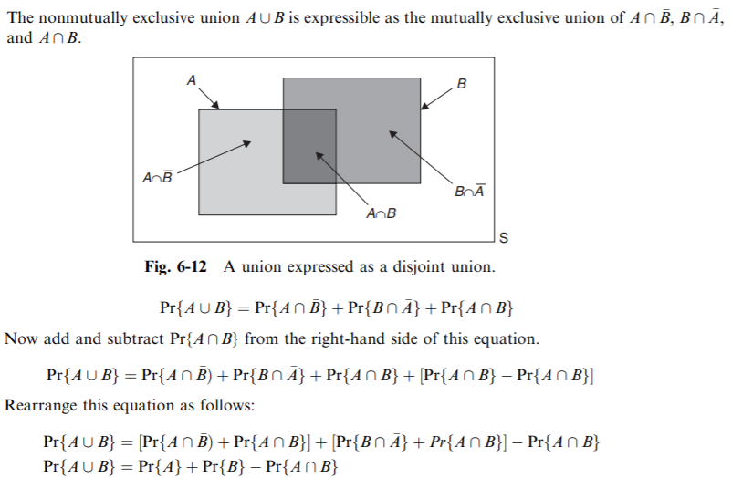
Venn diagram and basic relations

Slide 15
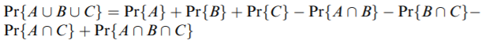
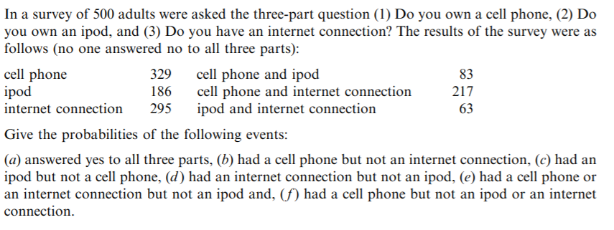
Probabilities with 3 event sets

Slide 16
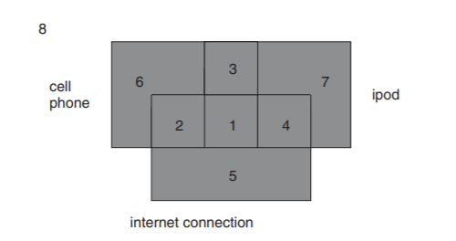
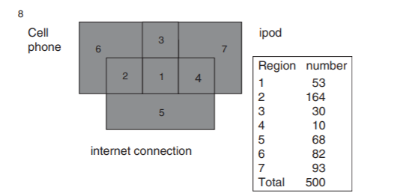
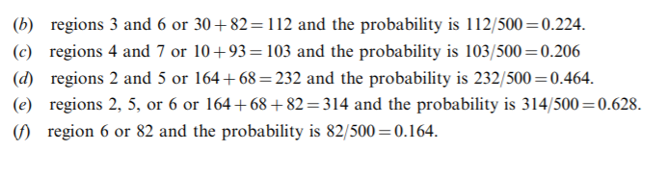
Give the probabilities of the following events: (a) answered yes to all three parts, (b) had a cell phone but not an internet connection, (c) had an ipod but not a cell phone, (d ) had an internet connection but not an ipod, (e) had a cell phone or an internet connection but not an ipod and, ( f ) had a cell phone but not an ipod or an internet connection.

Slide 17
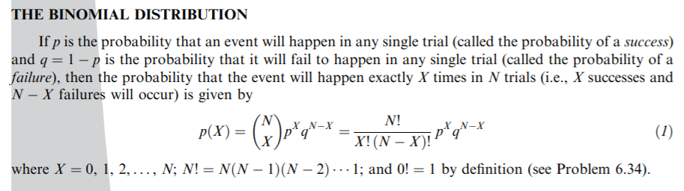
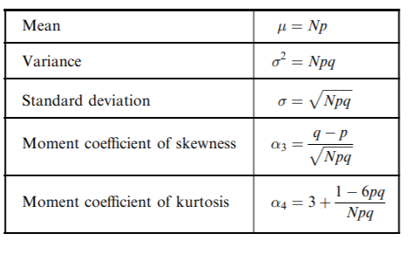

Slide 18
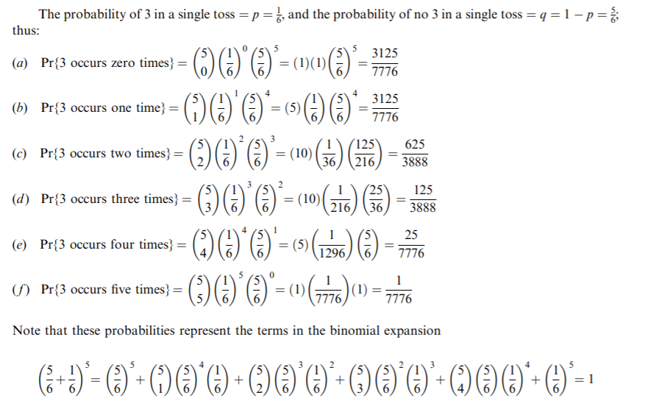
Binomial distribution
Find the probability that in five tosses of a fair die a 3 appears (a) at no time, (b) once, (c) twice, (d) three times, (e) four times, (f ) five times,

Slide 19
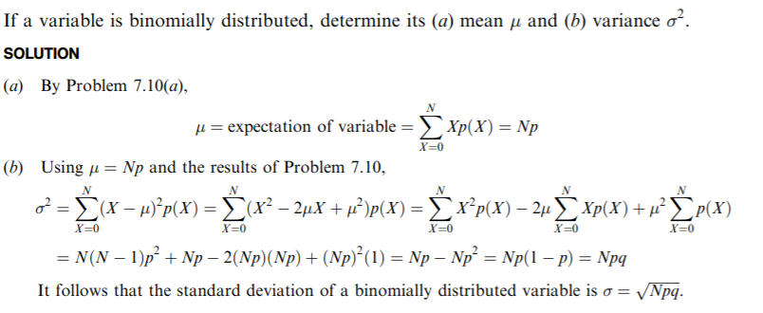

Slide 20
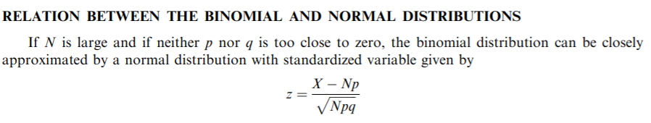

Slide 21
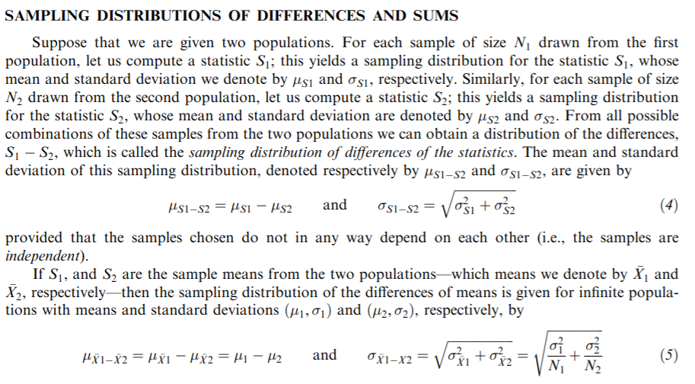

Slide 22
Standard error of difference between two means if the two sample sizes are not equal
where
- s₁: the sample SD of group 1
- s₂: the sample SD of group 2
- n₁: the sample size of group 1
- n₂: the sample size of group 2

Slide 23
Proportions
Find the probability that in 120 tosses of a fair coin
less than 40% or more than 60% will be heads and
(b) 5 8 or more will be heads.
SOLUTION
First method
We consider the 120 tosses of the coin to be a sample from the infinite population of all possible tosses of the coin.
In this population the probability of heads is p = 1/ 2 and the probability of tails is q = 1 = p = 1/2.
(a) We require the probability that the number of heads in 120 tosses will be less than 48 or more than 72.

Slide 24
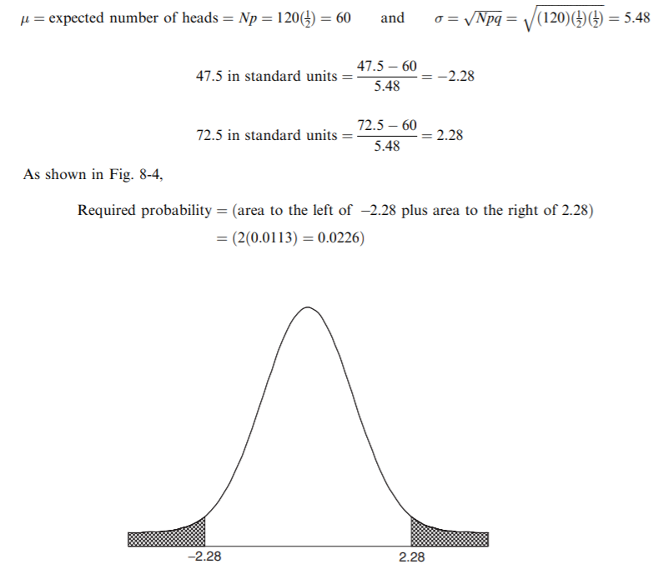
We proceed, using the normal approximation to the binomial.
Since the number of heads is a discrete variable, we ask for the probability that the number of heads is less than 47.5 or greater than 72.5.

Slide 25
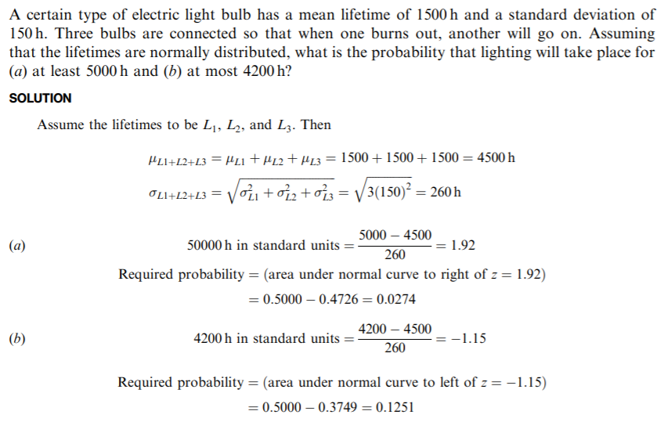
Example – Sampling distributions – difference and sums

Slide 26
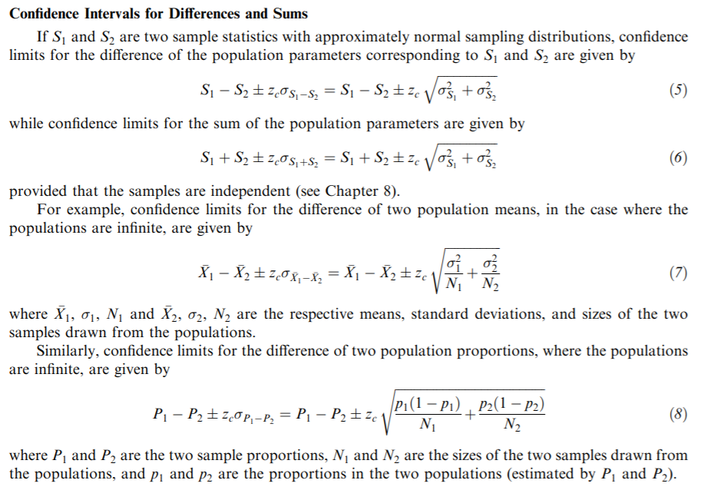

Slide 27
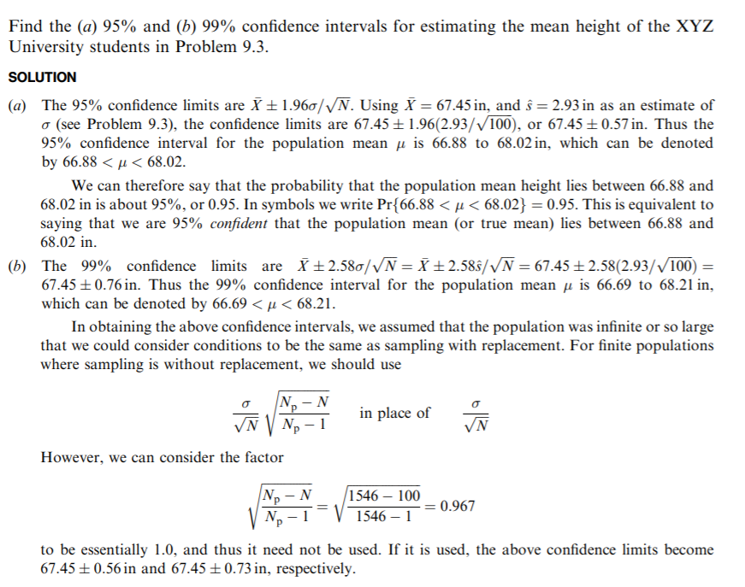

Slide 28
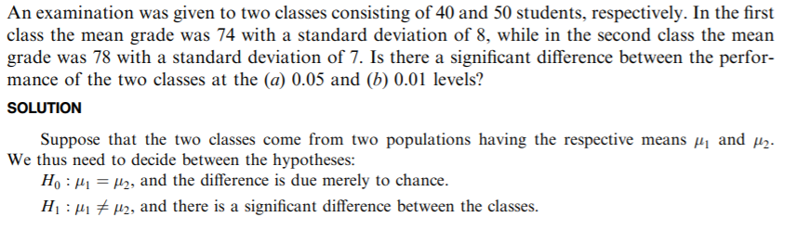
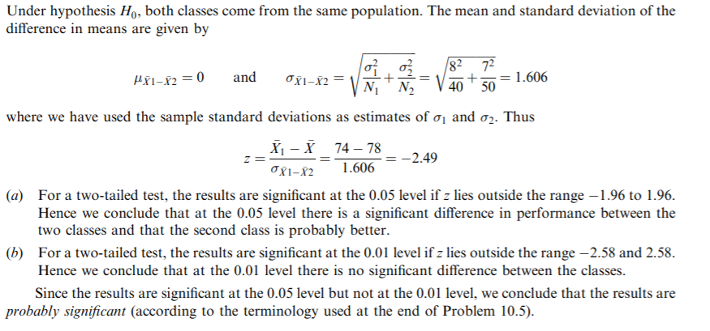

Slide 29
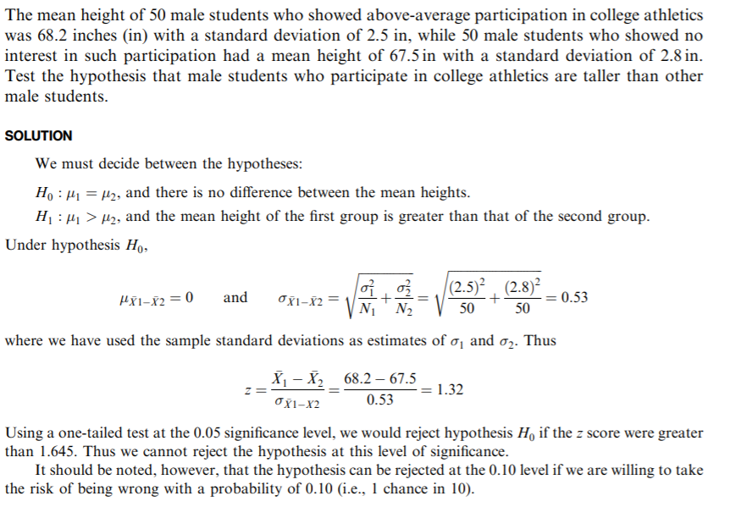

Slide 30
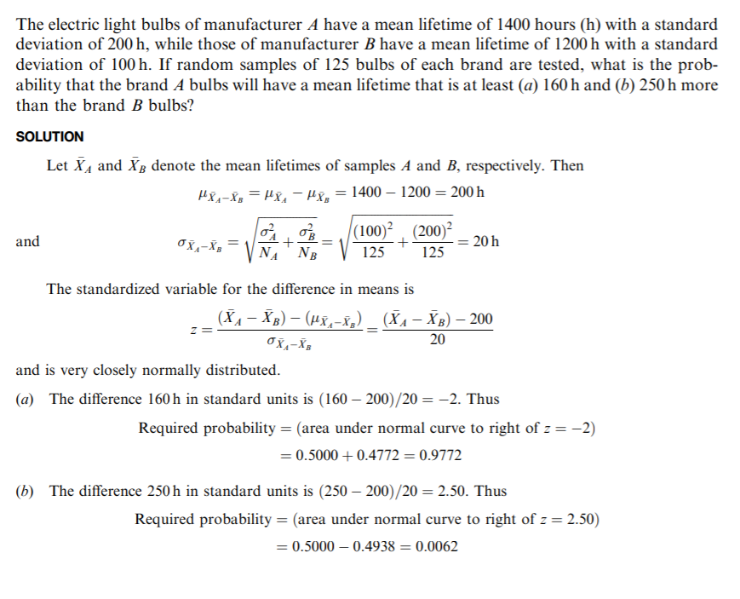

Slide 31
A study of sampling distributions of statistics for small samples is called small sampling theory.
However, a more suitable name would be exact sampling theory, since the results obtained hold for large as well as for small samples.
Here we see three important distributions: Student’s t distribution, the chi-square distribution, and the F distribution.

Slide 32
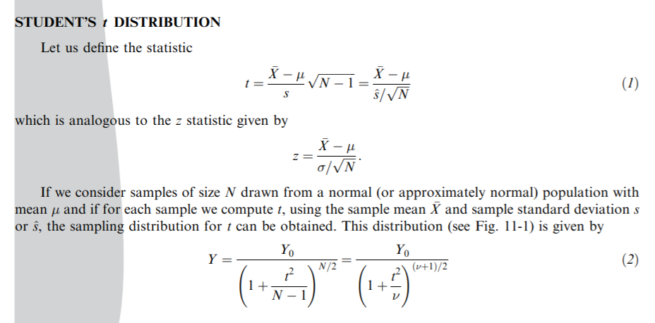
‘t’ distribution
If number of samples are < 30 then we use the following distribution for the mean.
But it depends on the number of samples per set, i.e., ‘n’ which is known as degrees of freedom.

Slide 33
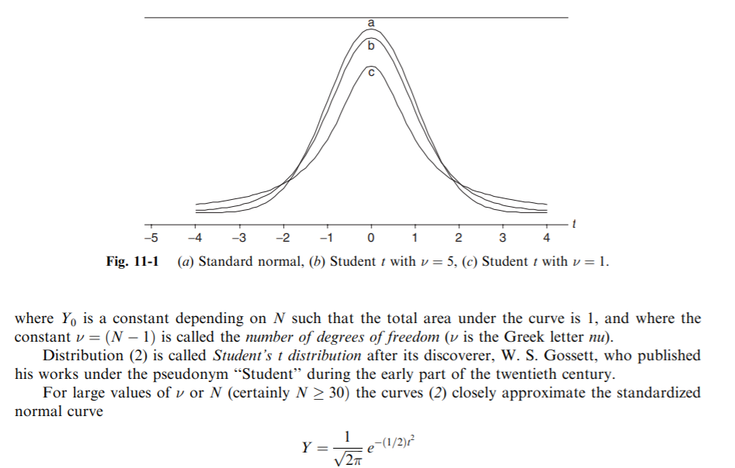

Slide 34
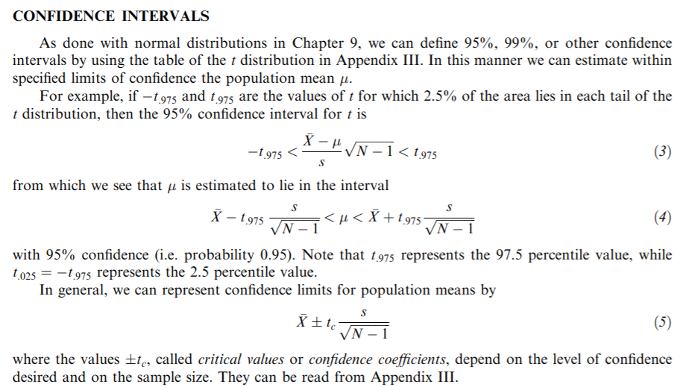

Slide 35
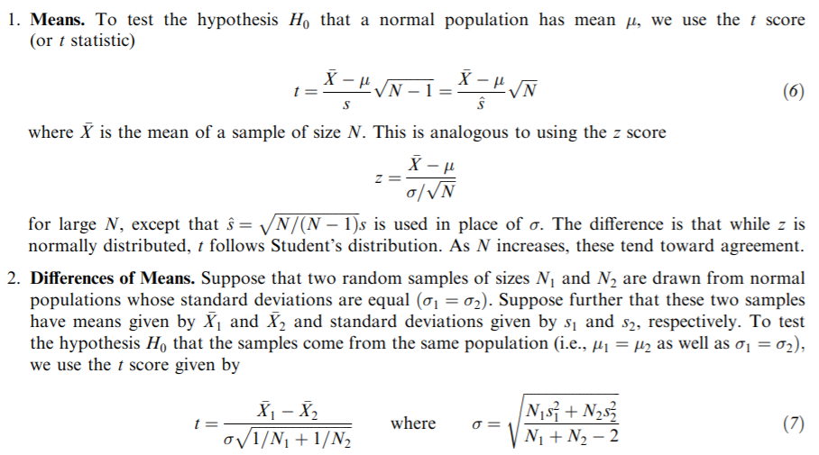

Slide 36
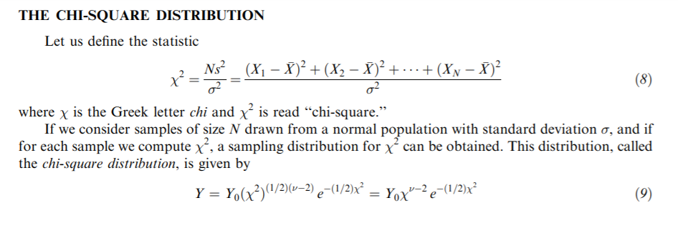
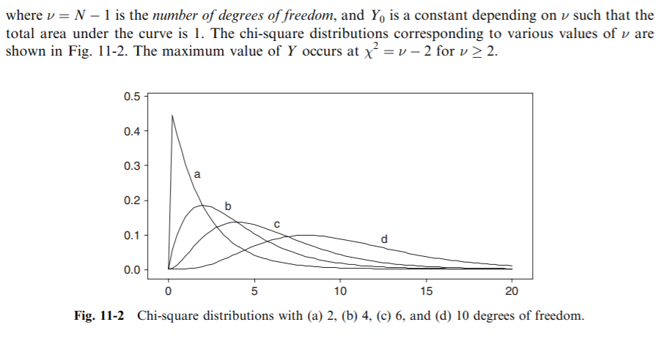

Slide 37
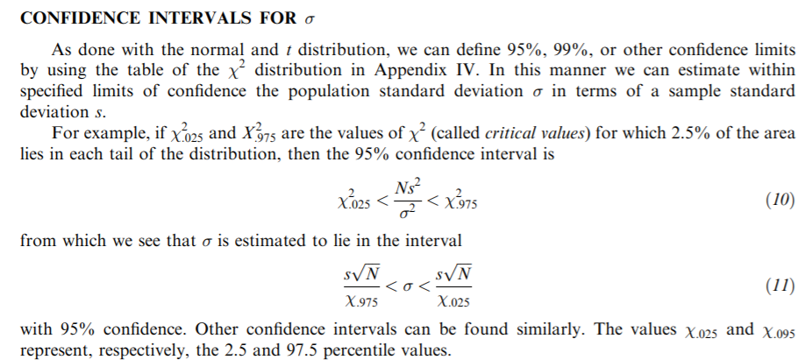

Slide 38
F distribution
As we have seen, it is important in some applications to know the sampling distribution of the difference in means of two samples.
Similarly, we may need the sampling distribution of the difference in variances.
It turns out, however, that this distribution is rather complicated.
Because of this, we consider instead the statistic S1^2/S2^2, since a large or small ratio would indicate a large difference, while a ratio nearly equal to 1 would indicate a small difference.
The sampling distribution in such a case can be found and is called the F distribution, named after R. A. Fisher

Slide 39
